Slide 1
HF:Studio
Welcome!
"Study group leadership: how to create good content that encourages collaboration among students”

Slide 2
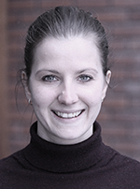
Who am I? Lene Ørbech Jensen - Student Advisor at IKOS - A part of the project HF:Studio - BA Pedagogy and MA in Guidance cancelling

Slide 3
Agenda
Get to know each other
Discussion
Short break
Case
General tips
Summary
Notes:
Ambisjonen vår er å nettopp besvare disse spørsmålene med gjennomtenkte og gode svar.

Slide 4
Get to know each other
Spend time creating a good and safe atmosphere
Example of an exercise you can do with your student group at the first meeting: Joke or facts? (5 min)
Two and two go together. They should introduce themselves to each other and tell something that is right, and something that is wrong. The other should find out what is a joke and facts. For example, one can give four pieces of information about oneself, three correct and one joke. (Feel free to take a review in plenary afterwards.)

Slide 5
Clarify expectations
Clarify expectations: a foundation for successfull collaboration
Both between you as learning assistant and the students, and between the students when they work in groups
Feel free to spend time on this in the first class with the students

Slide 6
Method: Think, pair, square
Give students time to think for themselves, put them together in pairs to discuss. Then you open up the discussion in groups or all together.
Students become more confident in speaking in class by having time to think through and discuss it with someone else first.

Slide 7
Question 1
Imagine that you are a new student in a course and will be part of a study group. What do you expect from the others?
1. Reflect and write down alone (2 min)
2. Two and two in pairs (5 min)
3. All together (2 min)

Slide 8
Question 2
What are the advantages and disadvantages of collaborating with other students / participating in a study group?
1. Reflect and write down alone (2 min)
2. Two and two in pairs (5 min)
3. All together (2 min)

Slide 9
Guidelines for student collaboration
What do you think are important guidelines for a study group? How should you work together?
1. Reflect and write down alone (2 min)
2. Two and two in pairs (5 min)
3. All together (2 min)

Slide 10
Summary guidelines
What are the goals?
Attendance (be on time, notify in case of delay or absence)
Effort (division of labor)
Be prepared (respect for each other's time and efforts)
Tip: Write down the expectations and publish them in Canvas. Remind students, if necessary, for example if students meet unprepared or someone does not contribute as much
Can be done both in a small study group, and/or all together

Slide 11
BREAK

Slide 12
CASE
As a learning assistant, you can experience three typical situations that get in the way of student collaboration:
1. There are different levels in the group.
2. A student do not contribute as much as the others (uneven participation).
3. One student takes up a lot of space and overrides the others (dominance).
Discuss what you as LA can do in these three situations (10 min)
All together (10 min)

Slide 13
What can you do as a learning assistant in these situations?
1. Different level in a group
The student who is at a higher level can be a resource for the rest of the group and support those who need more help.
2. Uneven participation
Refer to the guidelines.
Specify roles.
3. Dominance
Refer to the guidelines.
Use methods that make everyone participate (Think, pair, square, birthdate).
Control who takes the floor, and make sure that different students get to use their voice.

Slide 14
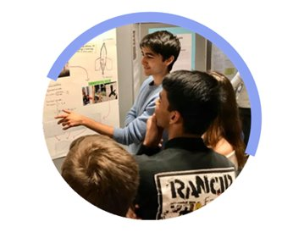
Spontaneous facilitation
When you share an observation and then ask an open question (what / how) at the group level, it is called spontaneous facilitation:
Input on what happens in the group there and then - learn from their experiences and take it further in other group collaborations
Repeating patterns
Feedback makes the group grow over time
Can also collect observations over a longer period and share them later with the group
Adapt the input to the group, some are not comfortable getting feedback
Share observations and challenges with other student assistants
Source: Experts in teams, NTNU

Slide 15
General tips
Clarify with the course instructor what your role is and what you should do before and along the way.
You are not an "expert".
Have a good structure at the seminars, be well prepared and set up a plan. Have a red thread between lectures and seminars.
Think about the learning environment. Learn the names and ask open-ended questions.
Come first and be the least to leave.
You set the standard in the first seminar. Be clear and give written instructions.
Especially with group work; make sure to clarify the tasks and discussions points.
Stay connected with other LAs within your field / department.
Summarizes at the end.

Slide 16
SUMMARY
What have you learned today?
What tools will you use as a
learning assistant?
GOOD LUCK!

