Slide 1
HF:Studio
Learning Assistants at the HF Faculty
Foundation module

Slide 2
Who am I?
Graciete Londrim
University lecturer at the Department of Literature, Area Studies and European Languages siden 2004
Adviser within the learning assistant scheme and internationalisation at HF

Slide 3
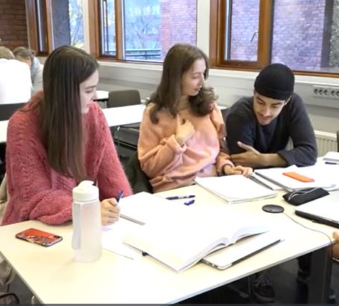
Agenda
What is a Learning Assistant?
What does a Learning Assistant do?
Why use learning assistants?
What is important for learning?
How to answer by asking a question?
The Learning Assistant experience
Make a plan for the first meeting with the students.
Some tips!

Slide 4
What is a learning assistant (LA) and what does a LA do?
Why do you want to be a learning assistant?
In what way can you support student learning?
Notes:
What is a LA? A student who has recently taken the course and has a fresh memory of what it was like to learn and what was difficult in the course.
A student who is seeking to help students strengthen their learning strategies and master course material.
A student who has an interest in teaching and a good understanding of the content.
A student who enjoys group activities and discussions.
What does the LA do? Helps students to learn the subject and to strengthen academic benefits.
Helps students to find the answers themselves and solve assignments, facilitates discussion of the syllabus, helps the students to identify needs and to tackle the needs. encourages active engagement and group interaction.
How: teach the students learning strategies, asks open questions that will guide the student through to the answer, asks open questions to make the students reflect and discuss the syllabus, ask students: What do you want to achieve in relation to the learning outcomes described on the course page? How much do you want to get involved? What do you want to learn or get better at?
Why do you want to be a learning assistant?
In what way can you support student learning?

Slide 5
What challenges do you think new students of the course have?
Notes:
Think about the course you are going to be LA for.

Slide 6
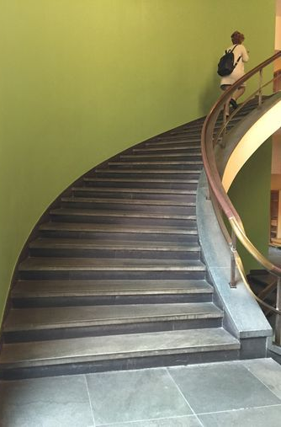
Students say that…
I think it was inspiring. And you can ask about almost anything and it's much easier to ask a LA than a professor and you can ask about anything as long
as it's within the university…
..it was inspiring that the learning assistants were nice ... My experience is that being nice in such a way lowers the threshold for asking questions. You get a different type of answer, you get a little more human answer, not always just purely academic…
I try to think back on what I remember best from the LAs, and I remember best the LAs who shared their own experiences. Who told a little about how it was when they worked with that exercise…
I imagine the learning assistants almost like a staircase, they take you along the small steps up. You'll sort of get there then. Also, they are with you the whole way and are more human in the process maybe…

Slide 7
So why use learning assistants?
Notes:
Many students greatly appreciate having professional contact with someone who has recently been a student in the course and knows what is like to learn the subject.
Students will learn more interactively
Student are exposed to a student-centered instruction
Learning assistants can be a bridge between the teacher and the students. Many teachers will benefit from knowing what you see that students find challenging.
What do you learn as a learning assistant?
As a learning assistant, you gain experience in leading groups, motivating students and organizing teaching. In addition, you learn a lot about your own subject, and develop as a professional.

Slide 8
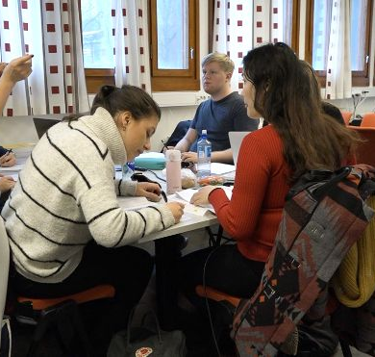
What is important for learning?
What we already know.
Clear goals and expectations.
Motivation, security and other emotions.
Relationships.
To understand concepts and contexts.
Practical examples.
Apply the knowledge, articulate understanding, trial and error.
Learning Environment & Collaboration

Slide 9
How to facilitate dialogue
What do you notice here?
How does the LA support students' learning?
How does the LA contribute to make the student articulate his understanding?
LINK Video kursHF HF21,pptx s.10 «artikulere forståelse»

Slide 10
What’s the right response?
Why didn’t the students like the response?
What do you think about the response?
What do you do if the students want you to give them answers?
LINK Video kursHF HF21,pptx s.11 «responsen»

Slide 11
How to answer by asking a question
There are many ways to be a learning assistant.
There is one common feature to all learning assistants: they should not lecture.
You can guide the students through to the answer with the right questions.

Slide 12
What questions can you ask?
Spiritually and religiously inspired environmental movements in Asia are largely overlooked as an essential contribution to the global goal of environmental sustainability
The project Asian Visions analyzes the mobilization of traditional Asian religio-philosophical ideas in response to the global environmental crisis.
Scholars, activists, and even politicians in India and China and Taiwan have found inspiration in traditional knowledge and in premodern texts and practices of, for instance, Daoist, Buddhist, Hindu, and Confucian traditions to envision more ecologically sustainable futures.
We will find out how these ideas about the value of human-nature relations are put into practice among contemporary policymakers, religious institutions, and spiritual-environmental movements.
We will carry out in-depth case studies in Asia that will help us analyze and assess the societal impact of such movements and, ultimately, their universal potential.
Notes:
What does the text say?
What are the key words?
Is “environmental sustainability” a main idea in the text?
What can possibly contribute to the goal of environmental sustainability?
Can traditional Asian religio-philosophical ideas help fight the global environmental crisis?
What does the project Asian Visions do?
Where does the inspiration to a more ecologically future come from?
What does the project Asian Visons want to find out?
What makes the text difficult?
Is the difficult because of words which are very loaded?

Slide 13
The story of Coca-Cola
Coca-Cola is probably the best-known drink in the world today.
What is the most recognizable object in the world? Could it be a football? Or a Big-Mac? No, the answer is a Coca-Cola bottle. The famous Coca-Cola bottle is over 100 years old !
Footballs and big macs are certainly part of life for lots of people; but Coca-Cola is now a permanent part of world culture. People know and drink Coca-Cola all over the world.
It is said that the Coca-Cola bottle is the most recognized object in the world. Hundreds of millions of people can recognize a Coke bottle by its shape, even if they cannot see it! And the famous Coca-Cola logo is the most famous logo in the world. Unlike any other famous commercial logo, it has not changed in 100 years!
Notes:
Can you identify the verbs?
What’s the tense of the verbs? Present? Past?
Can you identify in the sentences words that constrain the use of the tense?
The sentence “It is said that…” “it” refers to what? People?
Why the use of “it is said”
etc

Slide 14
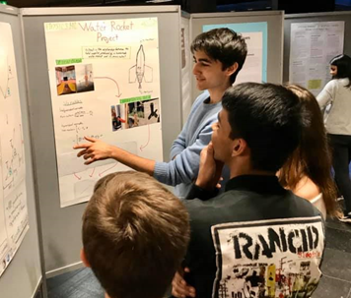
Facilitate learning by asking open-ended questions
Plan your questions - goals and a sequence of related questions.
Know your purpose - questions should elicit thinking and promote discussion.
Open conversation - open-ended questions invite the students to reflect. “What do you like best about this text?” generates more discussion than “Do you like this text?” Another tactic is to ask a question in the declarative format “Tell us about this paragraph.”
Don’t interrupt. Listen to the full answer to your question.
Transition naturally. Use something in the answer to frame your next question.
Notes:
Plan your questions - outline your information goals and a sequence of related questions.
Know your purpose. Every question you ask should elicit thinking and promote discussion.
Open conversation. Unlike simple yes-or-no questions, open-ended questions invite the students to reflect. “What do you like best about this text?” is likely to generate more discussion than “Do you like this text?” Another tactic is to ask a question in the declarative format — “Tell us about this paragraph .”
Don’t interrupt. Listen to the full answer to your question.
Transition naturally. Use something in the answer to frame your next question.

Slide 15
The Learning Assistant Experience
Objective:
Improve learning
Elicit thinking, reasoning
Facilitate discussion and
expression of ideas
Tools:
Questioning strategies
Group discussion
Group work
Learning strategies
Identification of goals and needs
Content:
Reflect on past week
Prepare for next week
Work through materials

Slide 16
Plan your first meeting
Introduce yourself.
Your study program and academic interests.
Why you said yes to being LA and how your skills contribute to the task.
Everyone introduces themselves.
Your role as a learning assistant.
Ask the students what are their expectations for the semester.
Notes:
Role as LA: To help students learn the subject and to strengthen academic benefits. Will facilitate for the students to solve the assignments themselves, will discuss the syllabus, will help the students to identify needs and to take measures to cope with the needs.
Expectations; What do you want to achieve in relation to the learning outcomes described on the course page? How much do you want to get involved? What do you want to learn or get better at?

Slide 17
Some tasks:
Help the students to find the answers themselves, ask new questions, discuss the syllabus.
Teach them learning strategies, both to make them aware of how they learn the subject and to strengthen the students' academic benefits.
Help students to decide what they want to achieve and develop strategies to achieve the goal.
Help students to identify needs and implement measures to address the needs.
Encourage students to plan for the week and to share individual plans for the week.
Conduct conversations and ask students questions to create reflection on the work process and encourage students to talk about what is going well and what is not going well, how the plan can be adjusted or whether it should be planned differently.
Gain access to Canvas and the timetable.
Be updated on the curriculum and on the activities every week.
Establish good contact with the teacher.

Slide 18
Example of a meeting with the students:
• Ask about what has gone well and what has not gone well. If something has not gone so well, you can follow up by asking what the reasons may be.
• Academic reasons - Work with the problem, the essay, text, the exercises, etc.
• Reasons related to the work process - ask the students if they plan the week for reading and how is the plan. Help them adjust the plan or make a plan (reading before lecture, after lecture, every morning, after training, etc.). Ask about what the students want to achieve and how much they want to get involved.
• Choose an item from the curriculum, an essay, text, exercises, etc., from the week in question, the previous week or the following week, and work through it with the students. You can suggest where they can get additional information.

